Slide 1
The Spread of Enlightenment Ideas

Slide 2
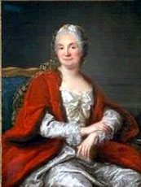
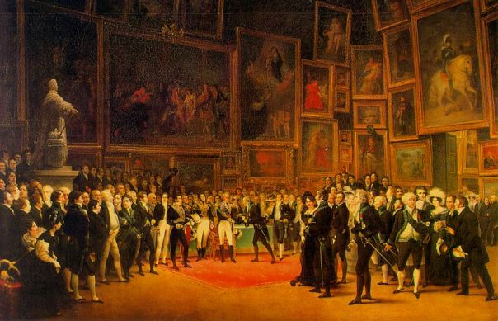
Paris
People met in Salons to discuss new ideas
Marie Therese Geoffrin

Slide 3
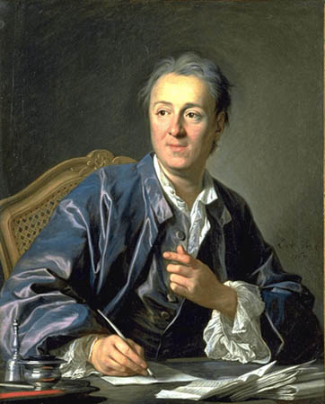
Denis Diderot

Slide 4
Denis Diderot
Isn't it better to have men be ungrateful, than to miss a chance to do good?

Slide 5
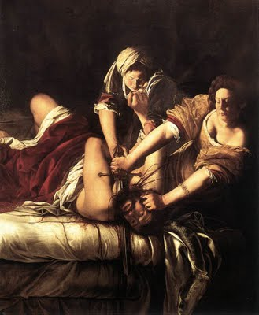
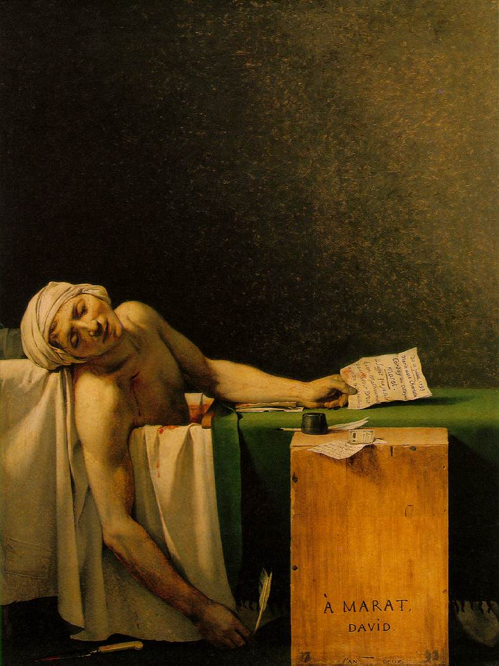
Baroque vs. Neoclassical

Slide 6
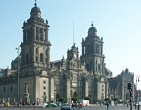
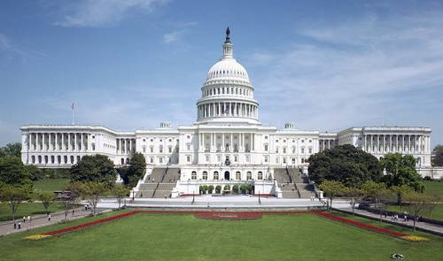
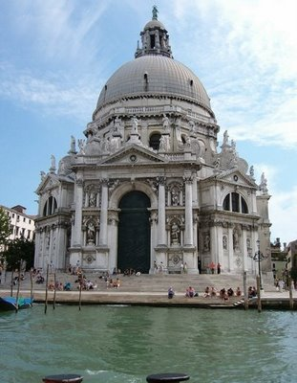
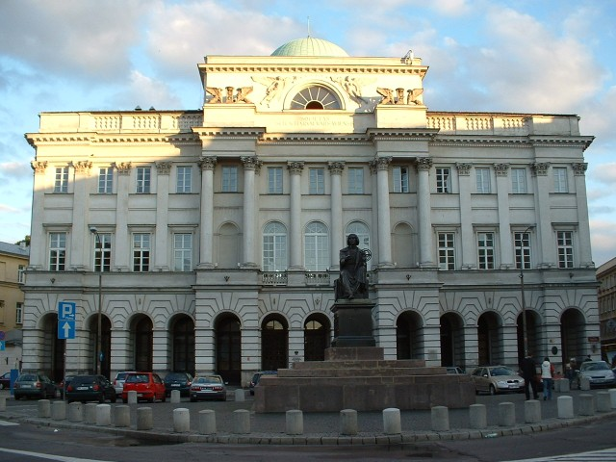
Baroque vs. Neoclassical

Slide 7
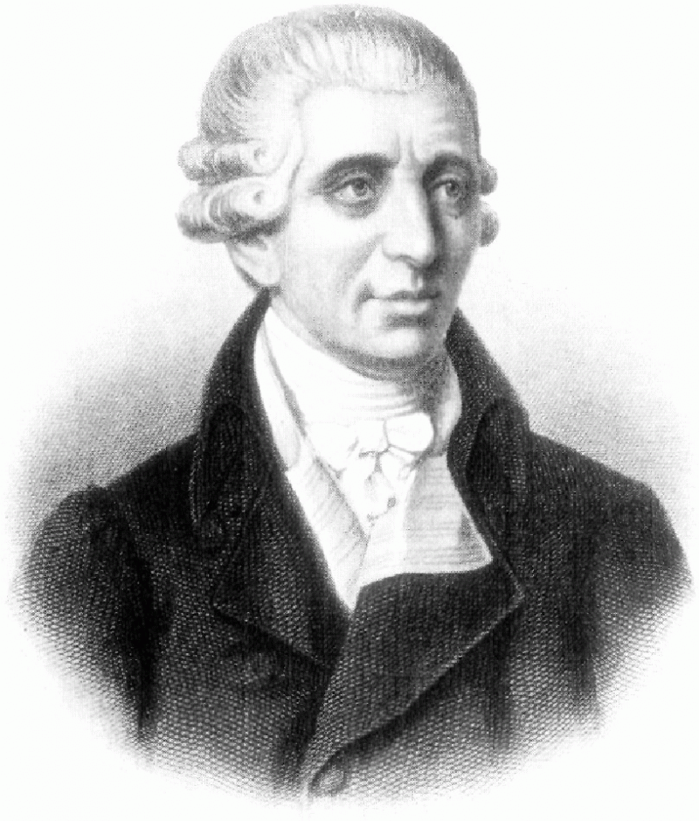
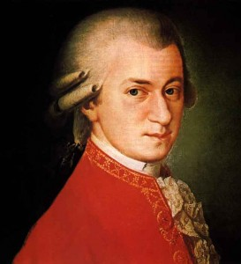
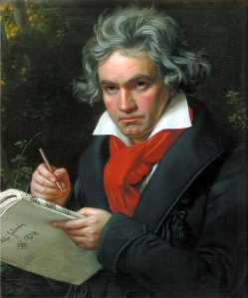
Classical Music

Slide 8
Enlightened Despots
Despot-an absolute ruler
Enlightened Despots—monarchs who embraced the new ideas and made some reforms

Slide 9
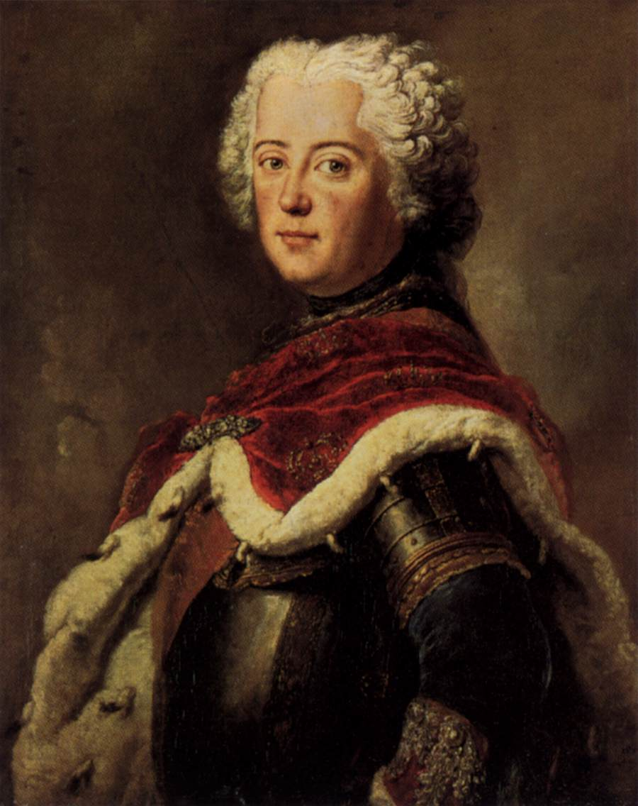
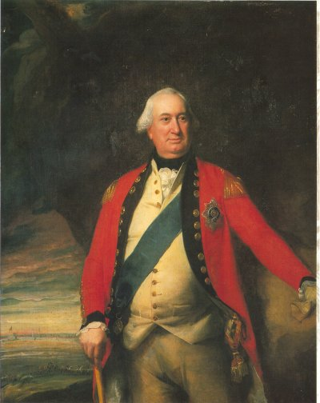
Frederick the Great

Slide 10
Frederick the Great
My people and I have come to an agreement which satisfied us both. They are to say what they please, and I am to do what I please.
Diplomacy without arms is like music without instruments

Slide 11
If my soldiers were to begin to think, not one would remain in the ranks
The greatest and noblest pleasure which men can have in this world is to discover new truths; and the next is to shake off old prejudices.

Slide 12
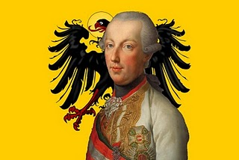
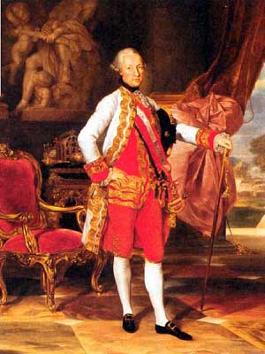
Joseph II

Slide 13
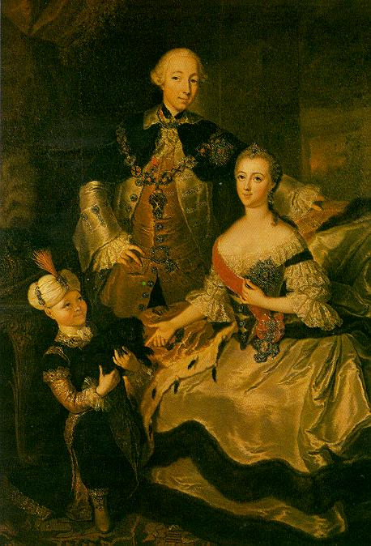
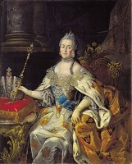
Catherine the Great

Slide 14
Catherine the Great
I shall be an autocrat, that's my trade; and the good Lord will forgive me, that's his
A great wind is blowing, and that gives you either imagination or a headache.
Power without [the people's] confidence is nothing.

