Slide 1
The French Revolution

Slide 2
The Estates General
Met in May 1789 at Versailles
Under the medieval rules, each estate got one vote
The Third Estate wanted to change the voting to voting by representative

Slide 3
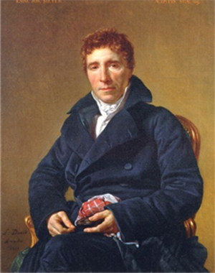
Abbe Sieyes

Slide 4
The Start of the Revolution
Louis insisted that the Estates General vote by estate
June 17, 1789—The Third Estate formed the National Assembly-invited representatives from the other estates to join them
The king locked them out of the meeting room

Slide 5
The Tennis Court Oath

Slide 6
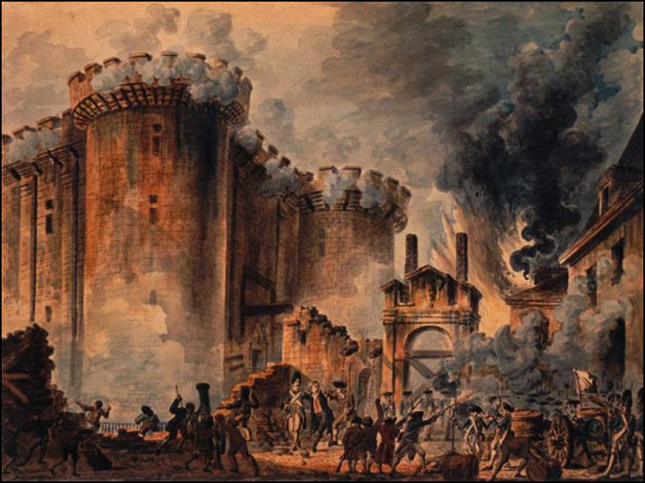
The Bastille
July 14, 1789

Slide 7
The Great Fear

Slide 8
The National Assembly Changes France
Declaration of the Rights of Man
All men born equal
Natural rights—life, liberty, property, security, and resistance to oppression
Granted equal justice, freedom of speech, and freedom of religion
Did not apply to women

Slide 9
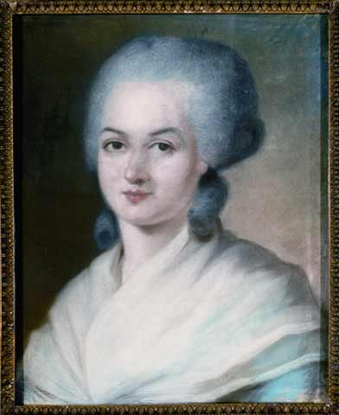
Olympe de Gouges

Slide 10
Accomplishments of the National Assembly
Declaration of the Rights of Man
Changed the relationship between France and the Church
Created a Limited Constitutional Monarchy
Prevented Louis XVI and family from leaving France

Slide 11
The Legislative Assembly
A Limited Constitutional Monarchy
Legislative Assembly had the power to make laws and prevent/approve wars declared by the king
Split into three groups:
Radicals
Moderates
Conservatives

Slide 12
Extreme Groups Outside the Legislative Assembly
Émigrés
Sans Culottes
Nobles and others who had left France in 1789
Were on the extreme right
Wanted to restore the Old Regime
Wage earners and small shopkeepers
Did not wear fancy knee length pants—their pants when all the way to their ankles
Wanted a bigger role in the government and an end to shortages

Slide 13
War!
France declared war on Austria in April 1792
Prussia then declared war on France
Both countries feared the Revolution spreading and wanted Louis XVI back on the throne

Slide 14
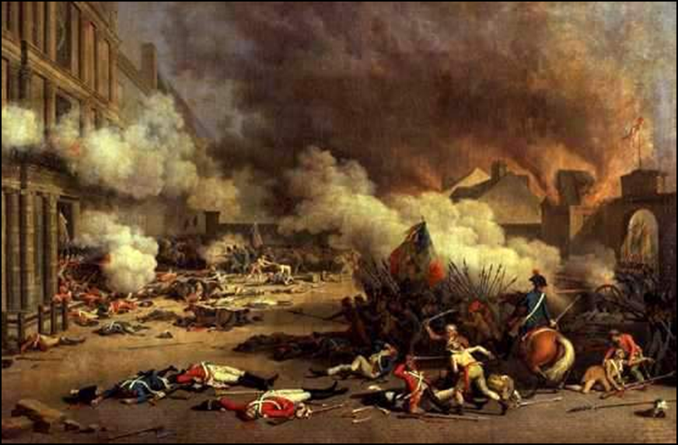
September Massacres
Prussian commander threatened to destroy Paris if any member of the Royal Family was hurt-July 25, 1792
Angry mobs attacked Tuileries Palace

Slide 15
The Legislative Assembly Reacts
Set aside Constitution of 1791
Deposed the king
Dissolved the Legislative Assembly
Called for new elections

Slide 16
The National Convention
Declared France a Republic
All adult male citizens had the right to vote and hold office
Louis XVI tried for treason and executed
Real power held by the Jacobins and angry mobs

Slide 17
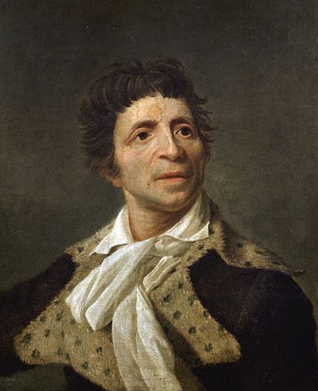
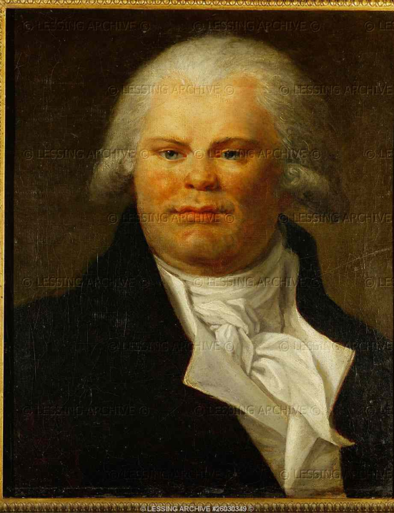
The Jacobins
Radical political club
Led by Jean Paul Marat and Georges Danton

Slide 18
A Republic of Virtue
Attempt to get rid of all royal influence
Changed decks of cards
Changes family names and place names
Got rid of Sundays and closed churches
Changed the calendar

Slide 19
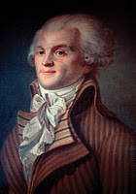
Maximilien Robespierre
Leader of the Committee of Public Safety
Tried to get rid of all the enemies of the Revolution

Slide 20
End of the Terror
Robespierre executed on July 28, 1794
French public opinion shifted to the right
Moderates wrote a new plan of government—The Directory
Two House Legislature
Five Man Executive

