Slide 1
Napoleon Bonaparte

Slide 2
Napoleon Bonaparte
born in 1769 on the island of Corsica
went to military school in Northern France
when the Revolution started, he joined the army for the new government
October 1795 royalist rebels marched on the National Convention, and Napoleon was asked to defend the government
became a hero and hailed as the savior of the Republic

Slide 3
Napoleons coup d’ état
by 1799, the Directory had lost control of the political situation
used his wife Josephine’s connections to influence their decisions
November 9, 1799-Napoleon was put in charge of the French military
November 10-drove the members out of one chamber of the national legislature
the other chamber voted to dissolve the Directory
established a group of three consuls—one of which was Napoleon
Napoleon took over as the first consul of the French Republic

Slide 4
The Second Coalition
Organized by Britain
Also included Austria and Russia
Goal was to drive Napoleon from power
Napoleon forced all three to sign peace agreements with France
1802-Europe was at peace for the first time in 10 years
Napoleon focused on ruling France

Slide 5
Europe in 1800

Slide 6
1800 Plebiscite
Plebiscite is a vote of the people
Gave all the real power to Napoleon
Napoleon’s title became First Consul
Overwhelming approved
Kept many of the Revolution’s changes

Slide 7
Napoleon and the Economy
Established an efficient tax collecting system
Established a national bank
Government had a supply of tax money and better control of the economy

Slide 8
Napoleon and the Government
Fired corrupt officials
Set up Lycées—government run public schools
Candidates for office could be appointed based on merit, not family connection

Slide 9
Napoleon and the Church
Signed a concordat with Pope Pius VII
Napoleon recognized the influence of the Church, but rejected its control of French affairs
French government would appoint bishops and bishops would appoint priests
Gave Napoleon support of the organized Church and most of the French people

Slide 10
The Napoleonic Code
Gave France a uniform set of laws and eliminated injustices
Limited personal freedoms and promoted order over rights
Took away some of the rights women had won in the Revolution
Freedom of speech and the press were restricted
Restored slavery to French colonies in the Caribbean

Slide 11
Influence of the Napoleonic Code
Wherever it was implemented [in the conquered territories], the Code Napoleon swept away feudal property relations.

Slide 12
Emperor Napoleon
in 1804 Napoleon made himself emperor
French voters supported him
December 2, 1804 the pope came to Paris to crown him at Notre Dame

Slide 13
“Consecration of the Emperor Napoleon & the Empress Josephine,”
1806

Slide 14
The Third Coalition
Started by Britain
Included Russia, Austria, and Sweden
Napoleon crushed the opposition
Battle of Austerlitz a turning point
All signed peace treaties with Napoleon except Britain

Slide 15
Battle of Trafalgar
Off the southern coast of Spain
British fleet commanded by Horatio Nelson—killed at the battle
British fleet destroyed the French fleet
Assured British naval supremacy for next 100 years
Forced Napoleon to give up plans for invading Britain

Slide 16
Napoleon on His Imperial Throne”
1806
By Jean Auguste Dominique Ingres

Slide 17
Marie Louise of Austria
Married Napoleon on March 12, 1810 in Vienna

Slide 18
Marie Louise with Napoleon’s Son

Slide 19
Napoleon's Three Big Mistakes

Slide 20
The Continental System
November 1806 Napoleon ordered a blockade of Britain
called it the Continental System—supposed to make continental Europe more self sufficient
the British responded with their own blockade
Continental System hurt Napoleon more than it hurt the British

Slide 21
The Peninsular War
1808- Napoleon sent an army through Spain to invade Portugal because Portugal was ignoring the Continental System
Spanish towns protested and Napoleon deposed the Spanish king and put his brother Joseph on the throne of Spain
Started nationalist feelings in Spain—people were very loyal to their former king

Slide 22
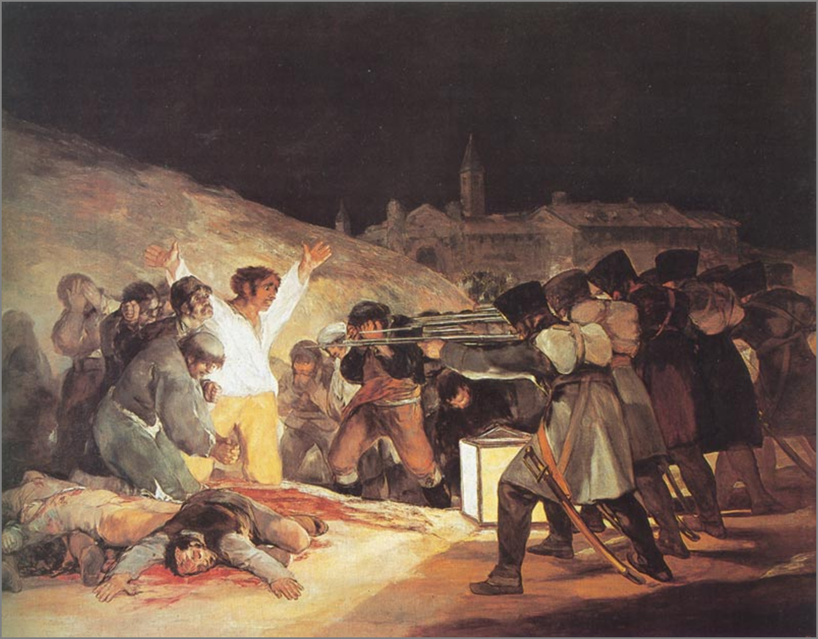
The Third of May by Goya
Commemorates the Spanish uprising against the French troops

Slide 23
Napoleon’s Family Rules!
Jerome Bonaparte -King of Westphalia.
Joseph Bonaparte - King of Spain
Louise Bonaparte - King of Holland
Pauline Bonaparte - Princess of Italy
Napoléon Francis Joseph Charles (son)- King of Rome
Elisa Bonaparte- Grand Duchess of Tuscany
Caroline Bonaparte- Queen of Naples

Slide 24
Napoleon’s Empire in 1810

Slide 25
The Invasion of Russia
Czar Alexander I of Russia was Napoleon’s ally, but he refused to stop selling grain to the British
Czar Alexander and Napoleon suspected each other of wanting to take over Poland

Slide 26
Napoleon decided to invade Russia with the Grand Army—June 1812
many troops were not French-had been drafted from all over Europe -had no loyalty to Napoleon
Czar Alexander pulled back his troops and used scorched earth policy
French army was starving

Slide 27
Battle of Borodino
September 7, 1812
Napoleon’s army won and allowed him to take Moscow
Czar Alexander had set fire to the city
Napoleon waited for a peace offer, but it didn’t come
by October it was too late to advance and too late to retreat, but it was getting cold

Slide 28
The Retreat
Russians attacked the retreating French army all the way back from Moscow
By mid-December the starving, freezing, wounded Grand Army was out of Russia-10,000 troops left

Slide 29
Napoleon’s Downfall
Forth Coalition-Britain, Russia, Prussia, Austria and Sweden
Napoleon raised another army and met the Forth Coalition outside of Leipzig
Forth Coalition destroyed the inexperienced army

Slide 30
The Hundred Days
Napoleon escaped from Elba and landed in France March 1, 1815
Within days, Napoleon regained his throne as Emperor of France
Louis XVIII fled
European armies once again fought Napoleon
Duke of Wellington led the British Army to the battle of Waterloo -June 18, 1815
Napoleon was defeated by the British and the Prussians

Slide 31
Napoleon’s Defeat at Waterloo
Duke of Wellington
Prussian General Blücher

