Slide 1
Hitler

Slide 2
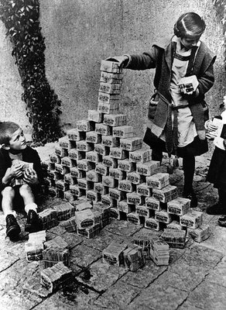
Germany after World War I
Massive Inflation
High Unemployment
National Socialists Party
(Nazi for short)began to gain followers
Received support from
lower/working class

Slide 3
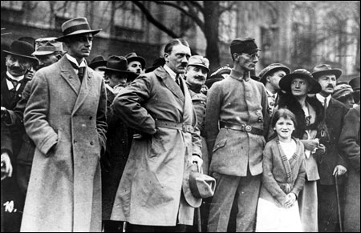
Beer Hall Putsch--1923

Slide 4
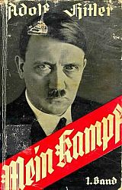
Mein Kamph
Laid out Hitler’s plans
Master Race
Jews, Gypsies, and Slavs were subhuman
Promised to retake lost lands
Germany needed lebensraum

Slide 5
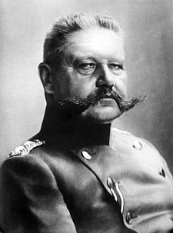
Paul von Hindenburg
German President
Appointed Hitler Chancellor of Germany in 1933
He thought he could control Hitler

Slide 6
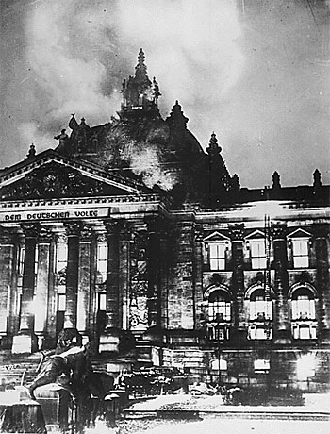
Reichstag Fire

Slide 7
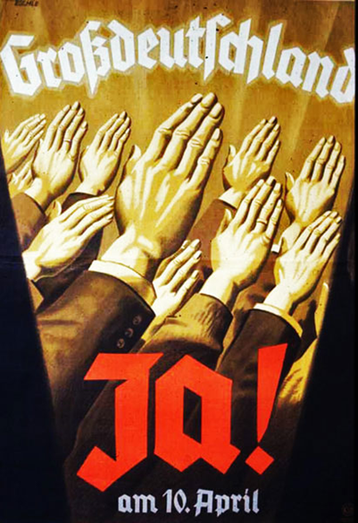
Nazis took Control of the Economy
Banned Strikes
Dissolved Labor Unions
Gave Government Authority over Business
Put Millions of Germans to Work

Slide 8
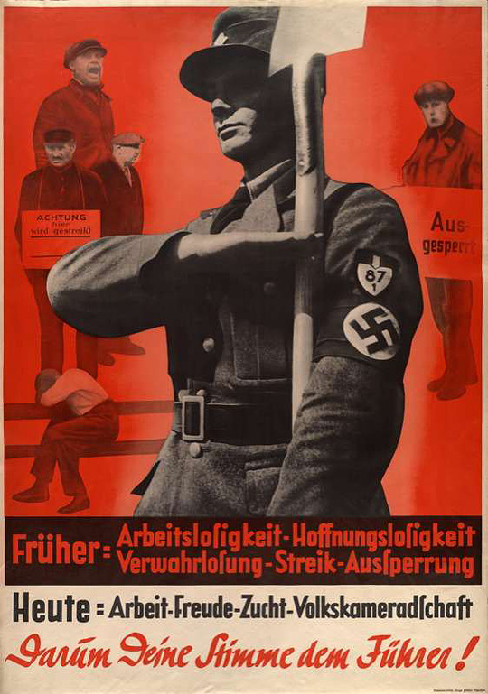
The Economy Improved
“Before: Unemployment, hopelessness, desolation, strikes, lockouts. Today: Work, joy, discipline, camaraderie. Give the Führer your vote!”):

Slide 9
Nazi Anti-Semitic Propaganda

Slide 10
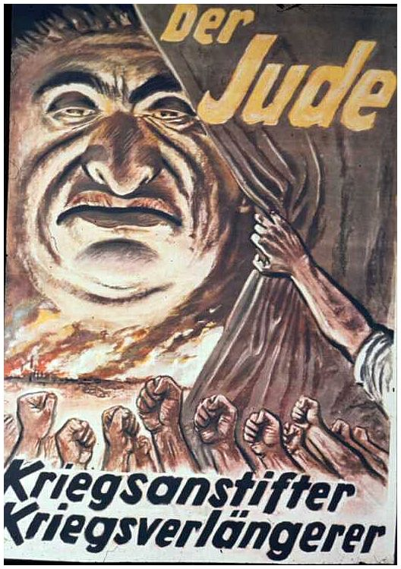
The Jew: The inciter of war, the prolonger of war 1943/1944

Slide 11
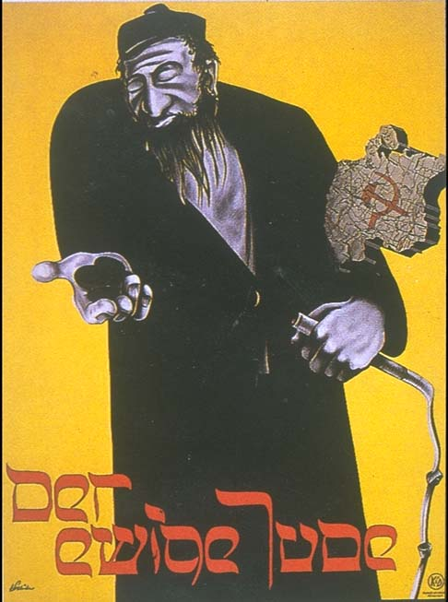
The Eternal Jew

Slide 12
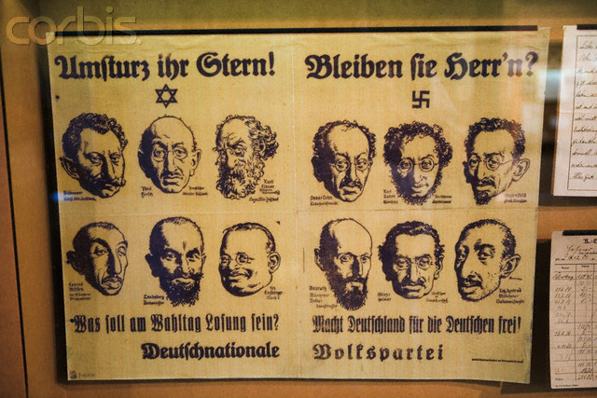
School Racial Chart

Slide 13
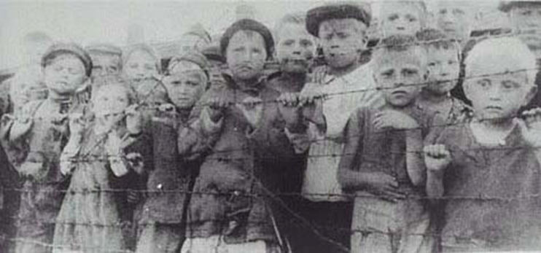
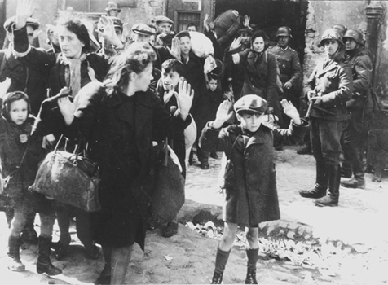
The Holocaust
The Holocaust was the result of Hitler’s anti-Jewish racial policies
It was the mass murder of millions of Jews, Gypsies, Homosexuals, and other people deemed sub human

Slide 14
Nuremburg Laws
Laws that restricted freedom and rights of Jews
Passed in 1935
Jews were no longer German citizens
No longer had a right to jobs or their property
Could not hold public office, teach, work for the government, or attend school
Jews were forced to wear a Star of David on their clothing so they could be identified

Slide 15
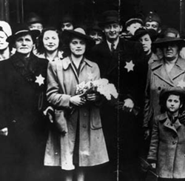

Slide 16
Kristallnacht
The Night of Broken Glass
November 9, 1938
Nazi Storm troopers attacked Jewish homes and businesses and synagogues across Germany

Slide 17
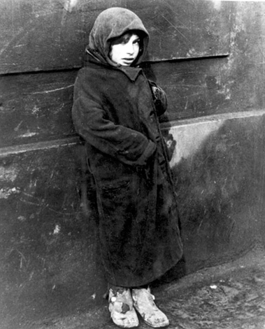
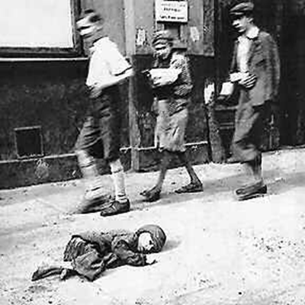
The Persecution Intensifies
Many Jewish people left Germany
Nazis forced Jews to live in ghettos-overcrowded, closed sections of cities
Wanted the Jews inside to die of starvation or disease—many did

Slide 18
World War II-September 1, 1939

Slide 19
German Troops March into Warsaw

Slide 20
The Final Solution
A program of genocide-mass killing of a group of people
Focused on Jews, but also included others considered undesirable—Gypsies, Homosexuals, the Disabled, the Insane, Russians, and Poles
The SS rounded up people and executed them in fields, burying them in mass graves

Slide 21
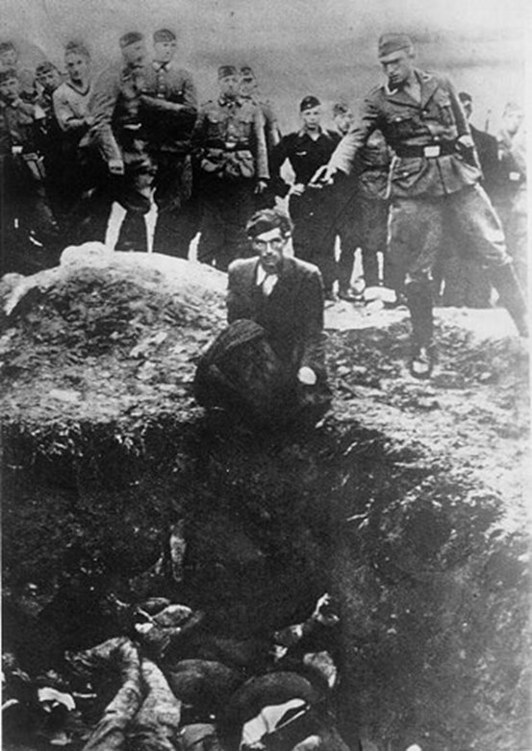
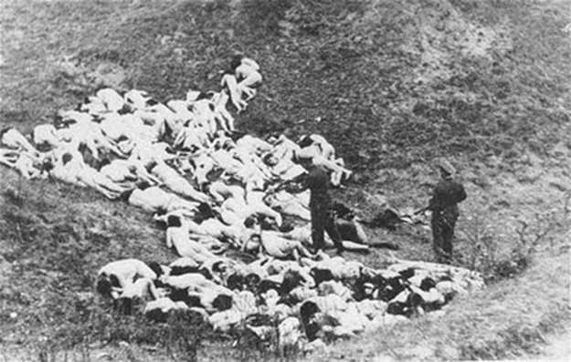

Slide 22
In 1941 the first Extermination Camps opened
They used massive gas chambers to kill up to 6,000 people a day
Prisoners were used for slave labor and thousands were worked to death
The bodies were burned in large ovens
In all 6 Million Jews died in the Holocaust

Slide 23
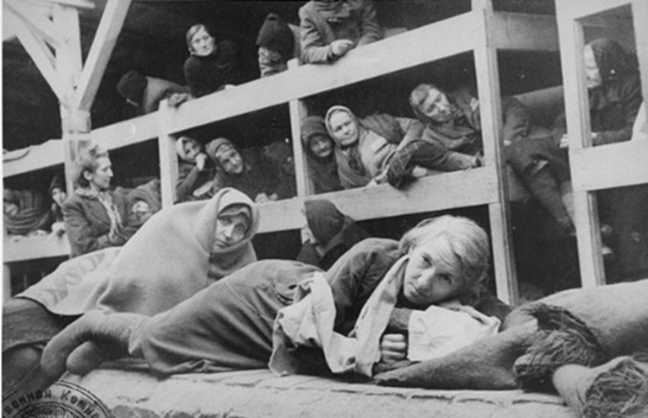
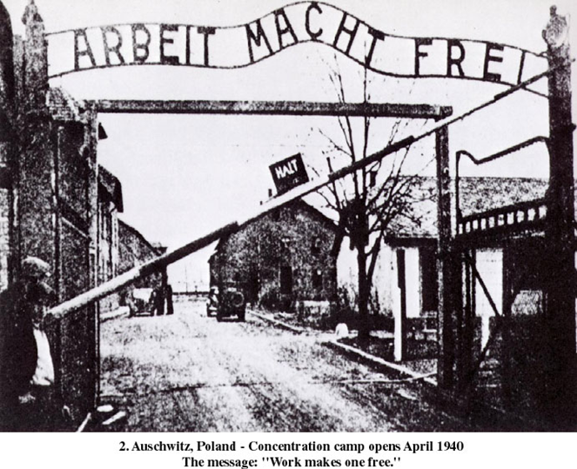
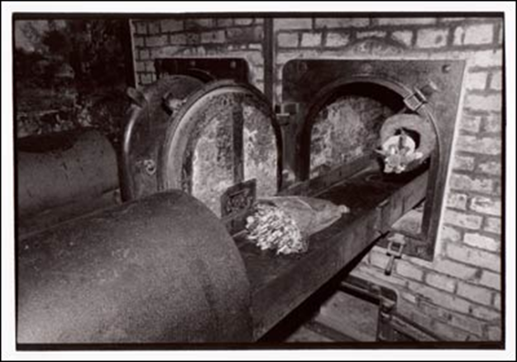

Slide 24
Impact of the Holocaust
Jewish Emigration
USA
Palestine/Israel
Creation of the country of Israel
conflicts in the Middle East we still deal with today
World’s Promise—Never Again
Cambodia, Bosnia, Rwanda, Darfur, etc.

