Slide 1
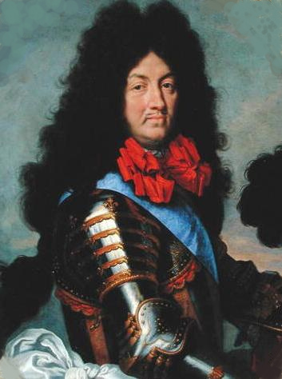
France in the Age of Absolutism

Slide 2
Huguenots
French Protestants
Followers of John Calvin
Between 1562 and 1598, eight religious wars

Slide 3
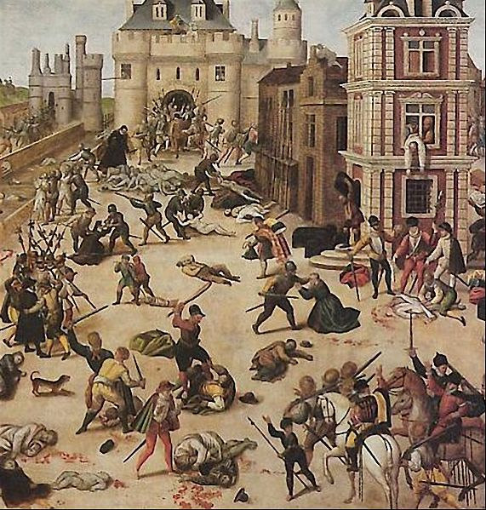
St. Bartholomew’s Day Massacre

Slide 4
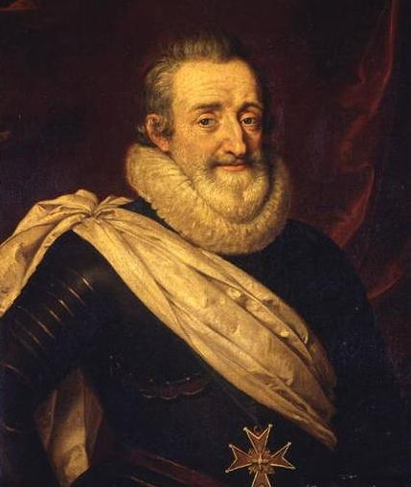
Henry of Navarre
Huguenot
Inherited the throne in 1589
First king of the Bourbon dynasty
Converted to Catholicism
“Paris is well worth a Mass”

Slide 5
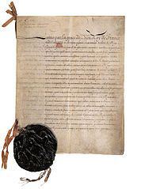
Edict of Nantes
Allowed Huguenots to live in France and set up churches in some cities
Religious toleration

Slide 6
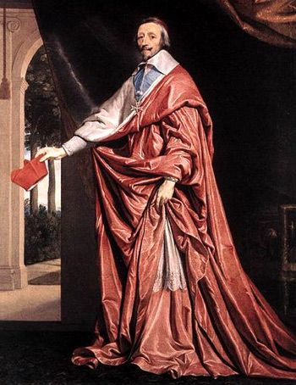
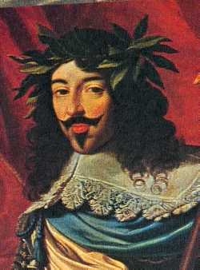
Louis XIII
Son of Henry IV
Appointed Cardinal Richelieu

Slide 7
Consolidating Royal Power
Moved against the Protestants
They could no longer have walled cities
Weakened nobles’ power
They had to take down fortified castles
Gave more power to the government agents from the middle class
Entered the 30 Years War against the Hapsburgs

Slide 8
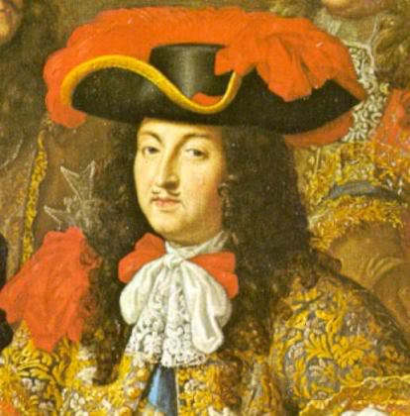
Louis XIV

Slide 9
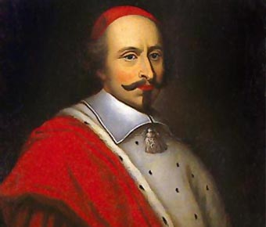
Cardinal Mazarin

Slide 10
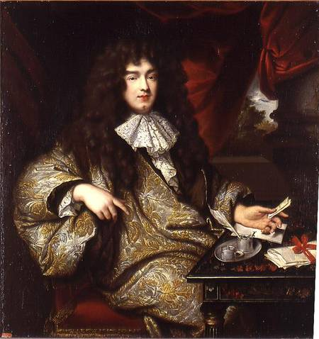
Jean Baptiste Colbert

Slide 11
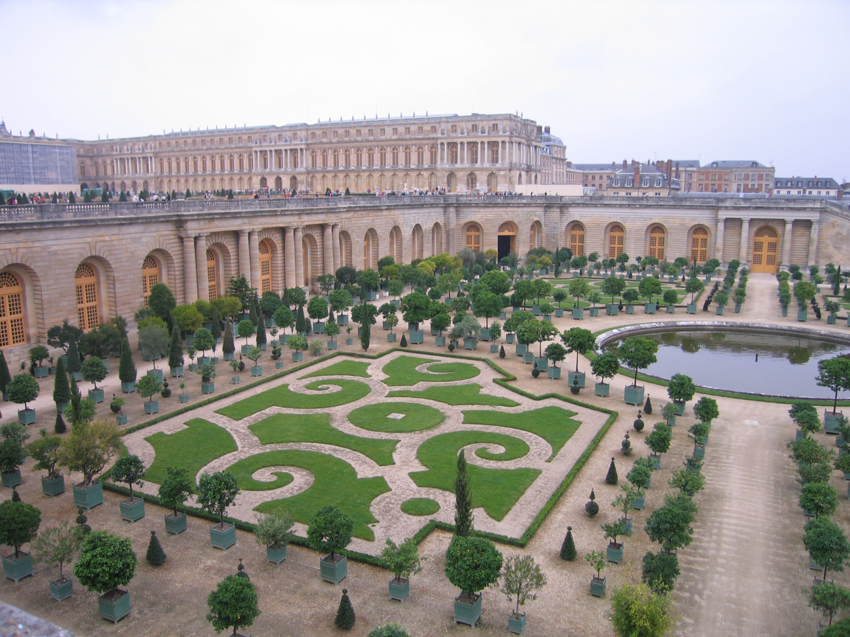
Versailles

Slide 12
The Wars of Louis XIV
1667-invaded the Spanish Netherlands
France gained several towns and expanded the boundaries of France
Other European countries banded together to match France’s strength
War of Spanish Succession
Ended with the Treaty of Utrecht
Britain was the big winner

