Slide 1
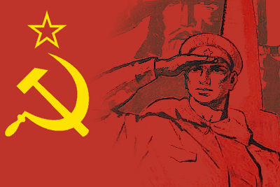
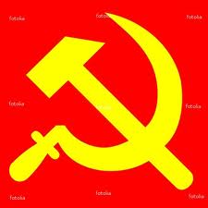
Communism Vocabulary

Slide 2
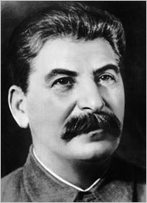
Dictator-a person in charge of a government with absolute power

Slide 3
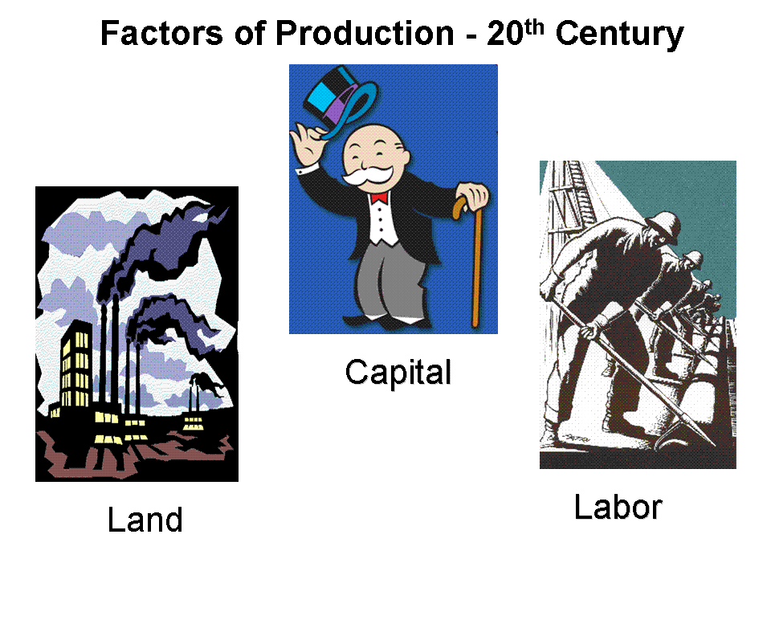
Means of Production-the stuff needed to make stuff
Land
Labor
Capital (MONEY!!)

Slide 4
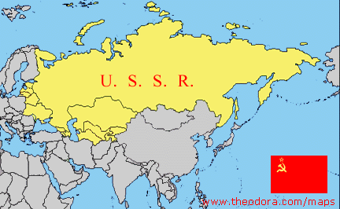
USSR-Union of Soviet Socialists Republics

Slide 5
Socialist-a person who believes that the means of production should be controlled by all the people (not individuals)
Believes in no private property

Slide 6
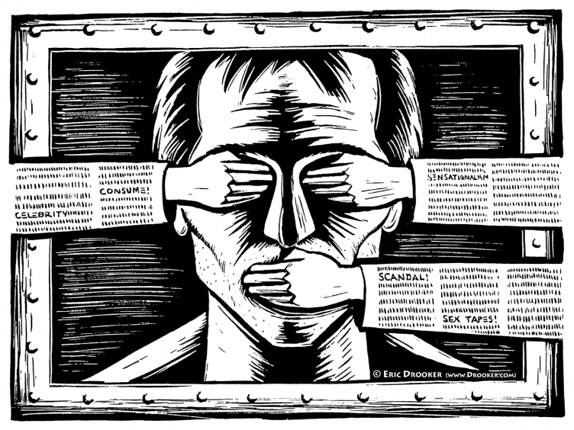
Censorship-when the government tells the people what then can and cannot write, sing, produce, draw, etc.

Slide 7
Police State- a country where the police act like the army and have unlimited power over the people

Slide 8
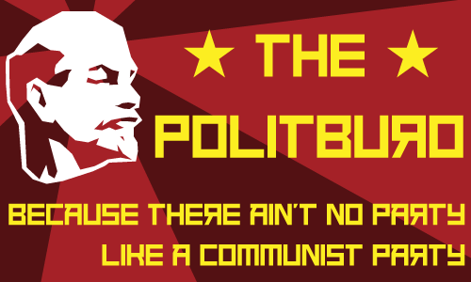
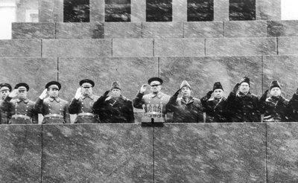
Politburo-head committee of the Communist Party
Makes all the decisions
In the USSR, it was the government

Slide 9
Nationalize-to put under government control and ownership

Slide 10
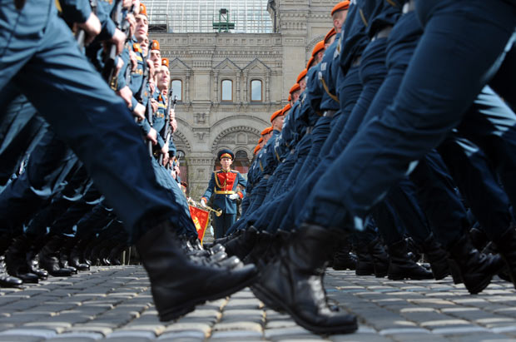
Totalitarian-a government with total control over its people

Slide 11
Command Economy- a socialist economic system where production and distribution of goods and services are controlled by the government and industry is mostly or completely publicly owned.

Slide 12
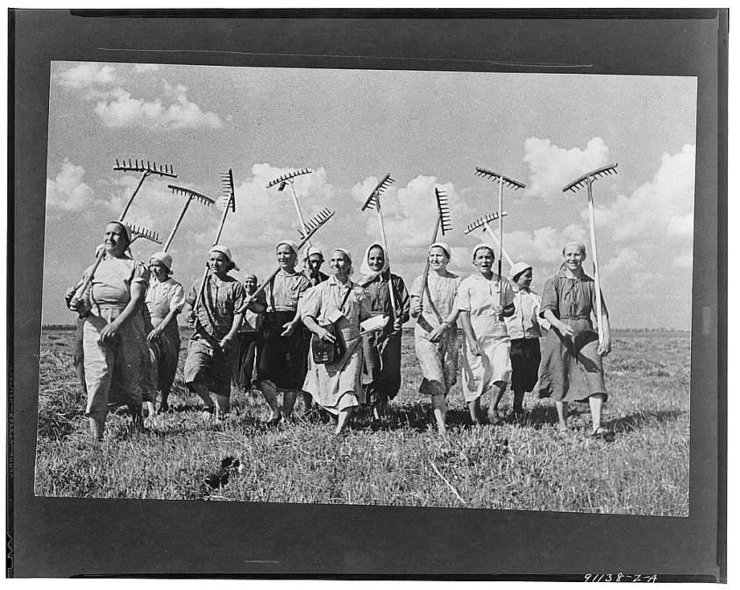
Collective Farm- a large farm created when small privately owned farms were nationalized and combined. All decisions on the farm made by the government.

Slide 13
Propaganda- news, movies, posters, art, literature produced to get people to do or believe something.

Slide 14
Every day life becomes more enjoyable!

Slide 15
"Thank you dear Stalin for a Happy Childhood!"

Slide 16
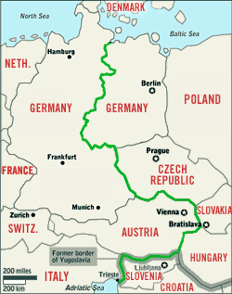
Iron Curtain- the imaginary line across Europe dividing the communist east from the democratic west.

Slide 17
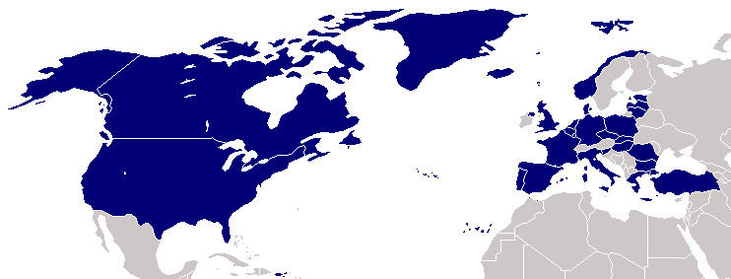
NATO- North Atlantic Treaty Organization
An alliance led by the United States of democratic countries against the Soviet led Warsaw Pact

Slide 18
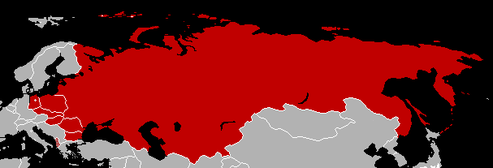
Warsaw Pact- an alliance led by the Soviet Union against the American led NATO

Slide 19
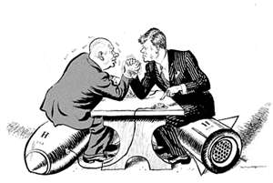
Brinkmanship- the willingness of both the USA and the USSR to go to the edge of nuclear war to maintain an advantage throughout the Cold War

Slide 20
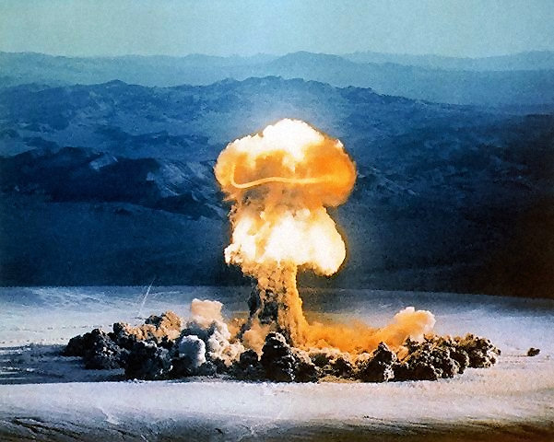
MAD-Mutually Assured Destruction
Idea that if the Soviets launched weapons, the United States would as well and both countries (and all others) would be destroyed, and vice versa.

Slide 21
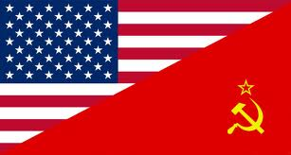
Cold War-years of tension and near war between the United States and the Soviet Union that never resulted in a shooting war
Lasted from 1945 to 1991

Slide 22
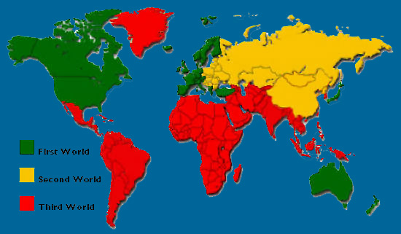
Third World- underdeveloped, poor countries

