Slide 1
April 2017 Battlefields of Europe

Slide 2
Amsterdam!

Slide 3
Anne Frank House

Slide 4
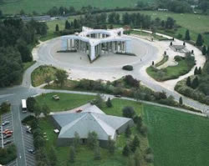
Bastogne, Belgium

Slide 5
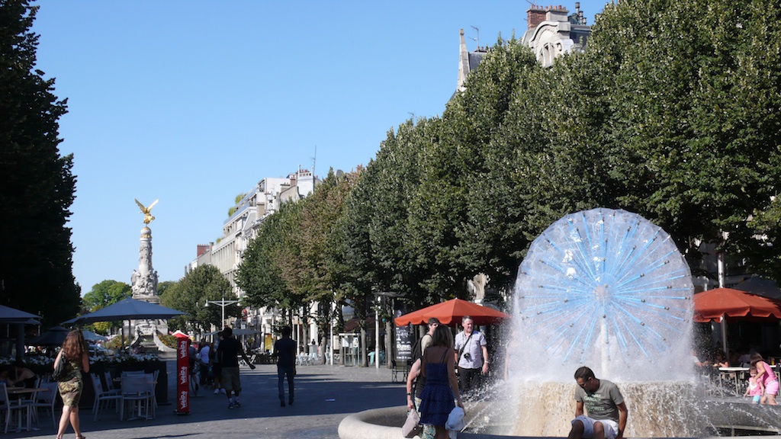
Reims, France

Slide 6
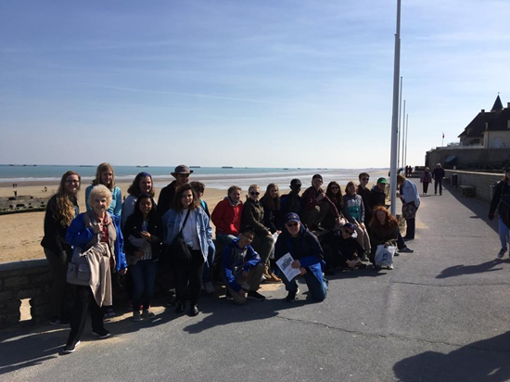
Normandy, France

Slide 7
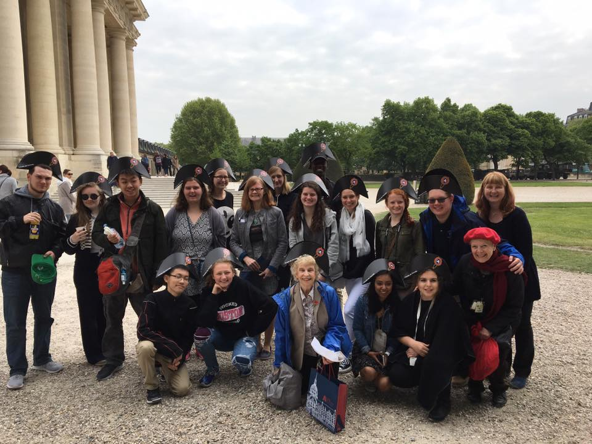
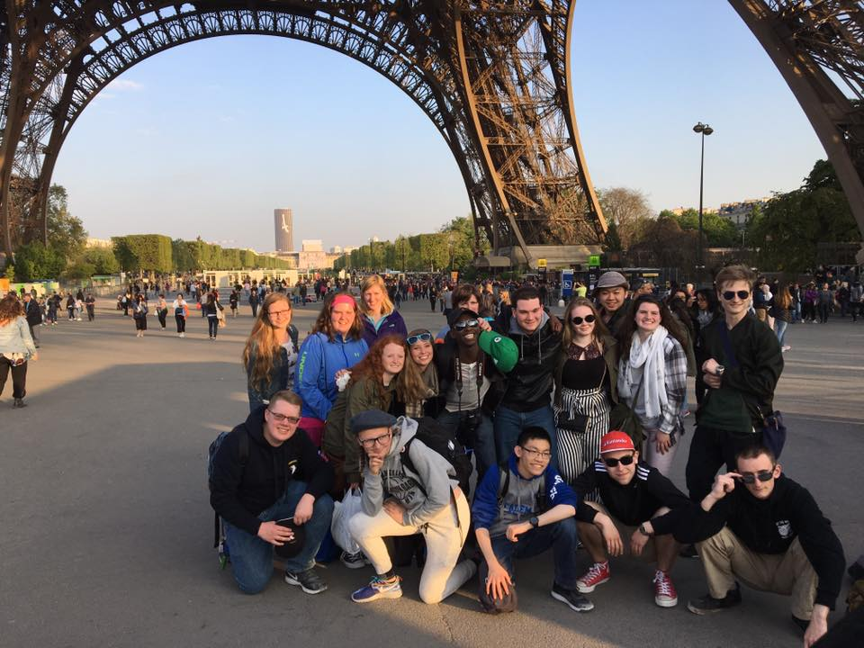
Paris!

