Slide 1
Auschwitz Krakow, Poland

Slide 2
A few things before you start. . .
These pictures are disturbing. They should be. Auschwitz is the sight of the largest mass murder in history.
The pictures cannot communicate the size and feeling of Auschwitz. For that you have to go and see it for yourself.
I took almost all of these pictures. The ones I did not take have a blue outline. (There are parts of the site you cannot use a camera.)

Slide 3
What we call Auschwitz was 3 camps-Auschwitz I, II, and III
Auschwitz I was a former army base. When the Nazis took it over, it became a work camp. Today it houses the museum and memorial.
Auschwitz II (also known as Birkenau)was the death camp. Most people who arrived there went directly to the gas chamber. The hundreds of barracks housed workers for Auschwitz III and other slave labor. Today it looks just like it did when the Soviet Army arrived in 1945.
Auschwitz III was a series of factories for the Nazi war machine. It is not open for visitors.

Slide 4
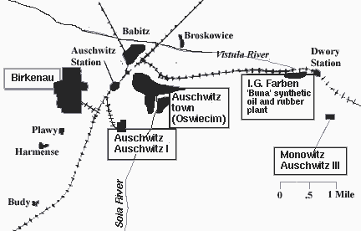

Slide 5
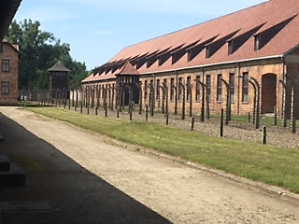
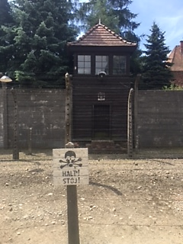
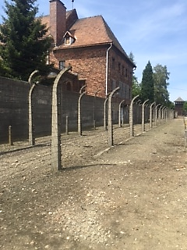

Slide 6
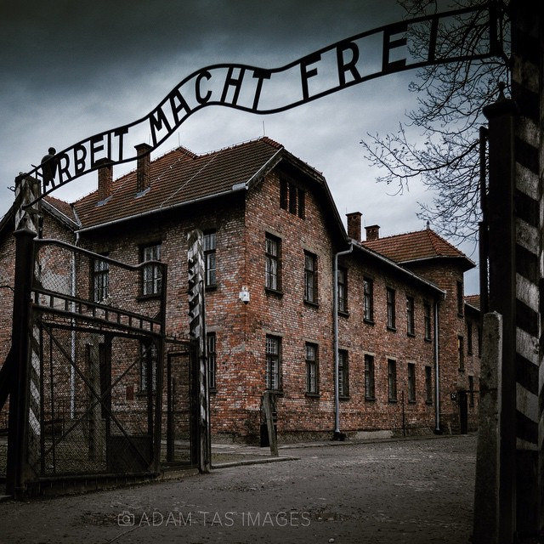
Work Will Make You Free

Slide 7
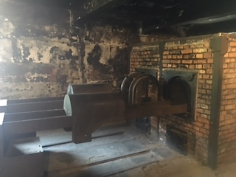
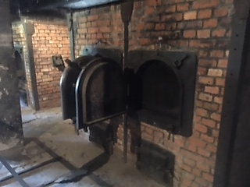
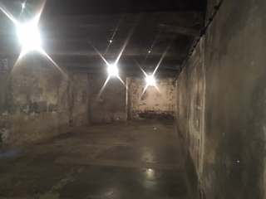
Small Gas Chamber, Auschwitz I

Slide 8
Museum and Memorial at Auschwitz I
Urn containing ashes of some victims
According to survivors, ashes were thrown in the river, scattered on the grounds, and tossed in the woods
When you walk around Auschwitz, you walk on the ashes of victims

Slide 9
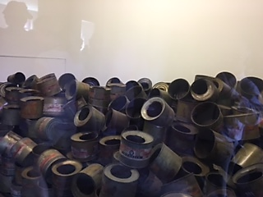
Poison Gas Canisters

Slide 10
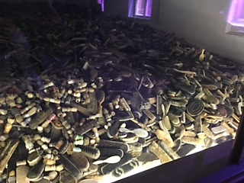
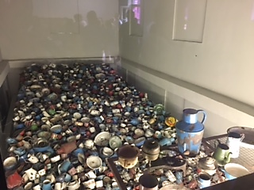
Personal Belongings of Victims

Slide 11
The Holocaust was also the largest theft in all of human history.
Victim’s belongings were all taken from them.
Some of the things they brought with them are in the museum. Most of their belongings were used for the Nazi war machine or given to Germans who had been bombed.

Slide 12
Personal Belongings of Victims
The Nazi’s first victims were the disabled
The first use of poison gas was in vans where the Nazis poisoned the physically and mentally disabled

Slide 13
Personal Belongings of Victims

Slide 14
Victim’s Hair

Slide 15
Barracks in Auschwitz I

Slide 16
Execution Wall

Slide 17
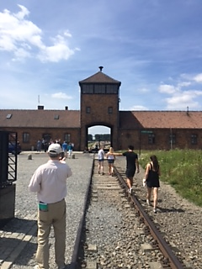
Auschwitz II

Slide 19
Train platform inside the camp
This was the last place many place saw their loved ones

Slide 20
Gas Chamber at Auschwitz II
Three massive gas chambers and crematoria at Auschwitz II were blown up by the Nazis as the Soviet Army approached
Their remains have not been touched since 1945

Slide 21
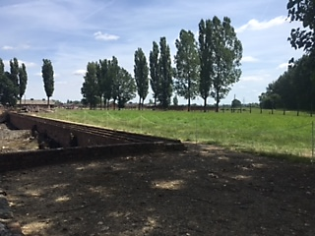
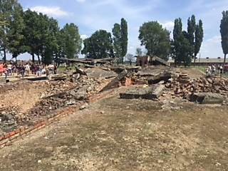
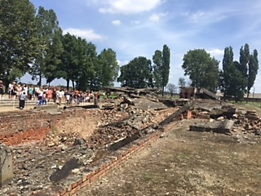
Gas Chamber at Auschwitz II

Slide 22
The camp is massive, much bigger than pictures show
The plan was for it to be bigger. The Red Army arrived before the Nazis could finish building all of the planned for barracks

Slide 23
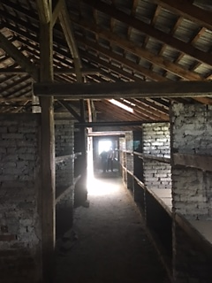
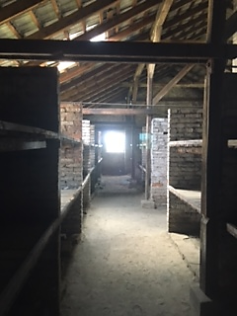
Barracks at Auschwitz II

Slide 25
Facts that stuck with me. . .
Auschwitz is Hungary’s largest cemetery. It is in Poland.
The first tours of Auschwitz were given by survivors. Despite what had to be and emotionally draining and extremely difficult story to tell, they wanted the world to know.
The place is huge. The pictures do not you a good idea of the size.
Auschwitz has almost 2 million visitors a year.

